Slide 1
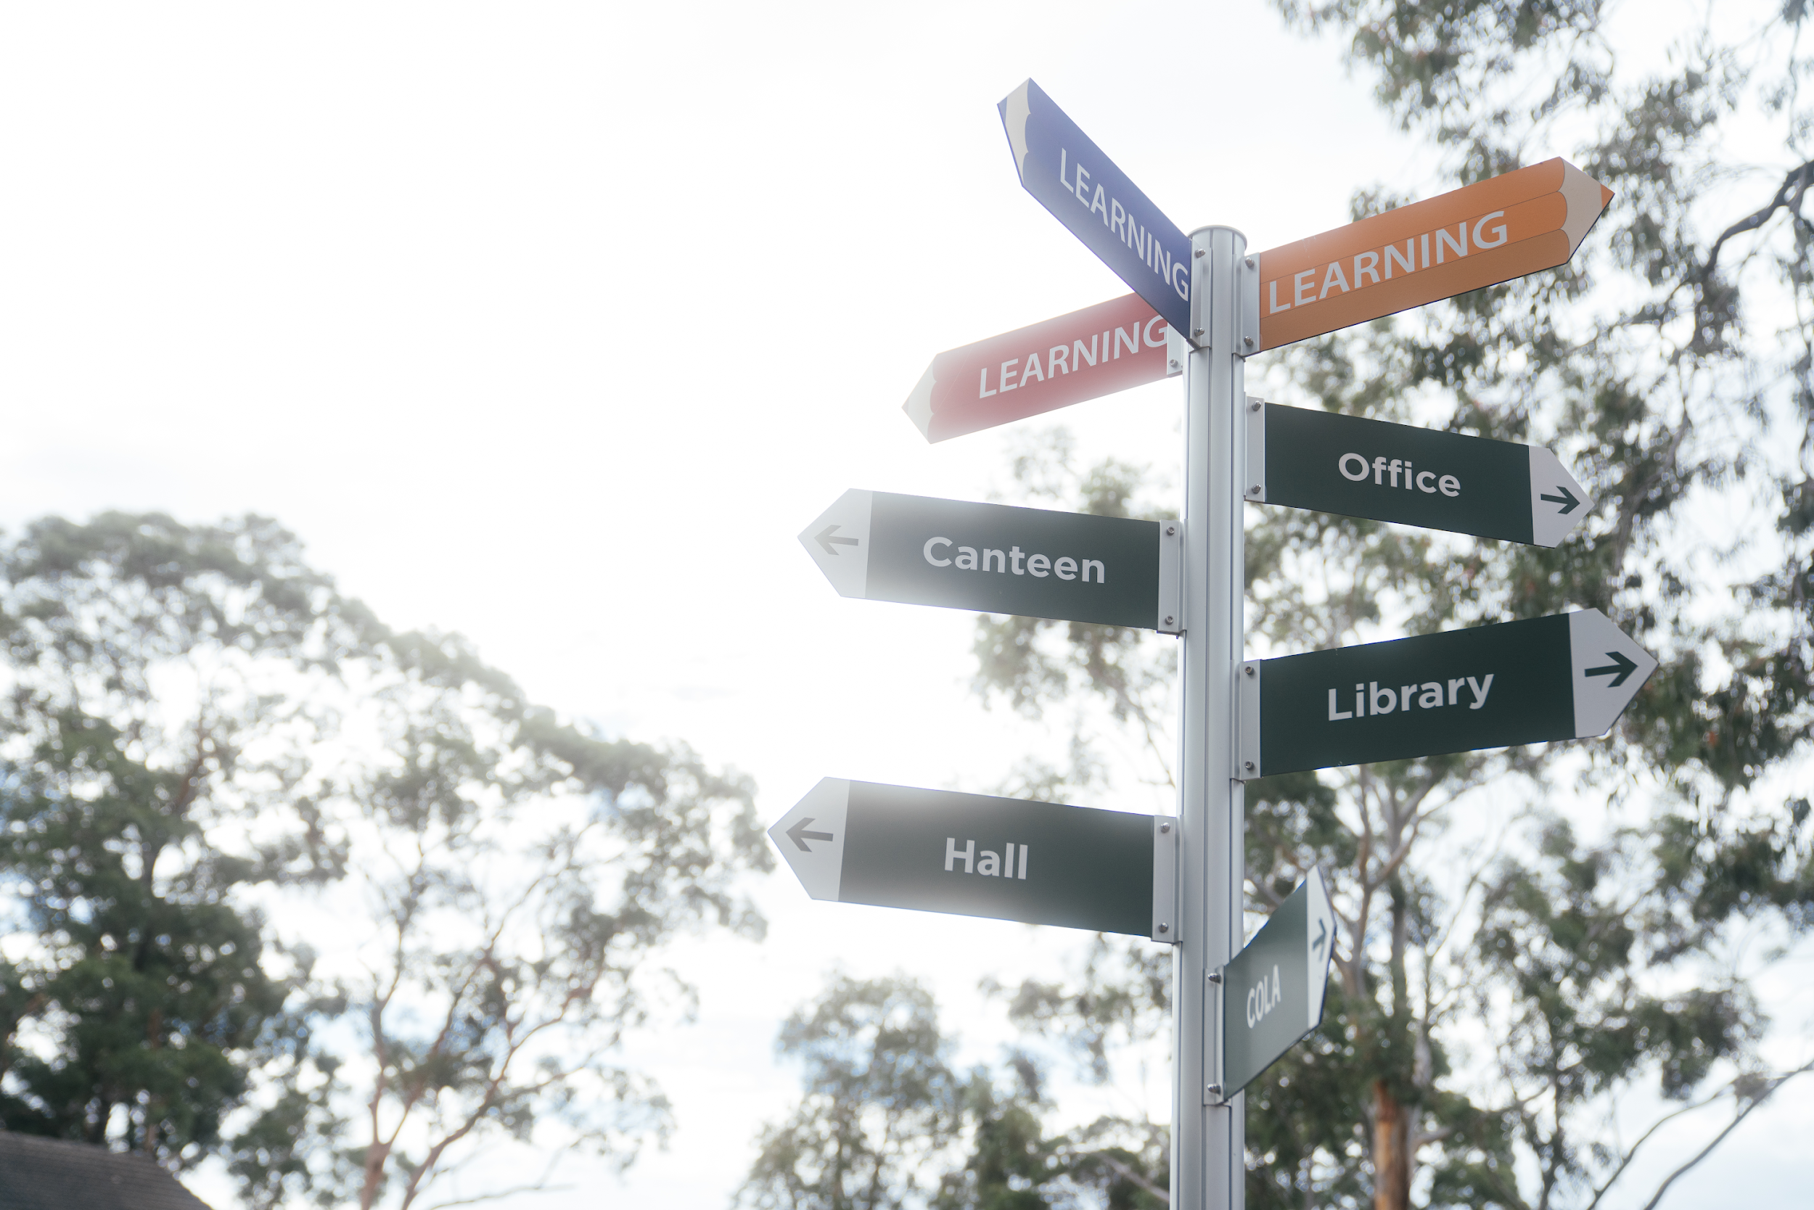
Welcome to LPS
2024

Slide 2
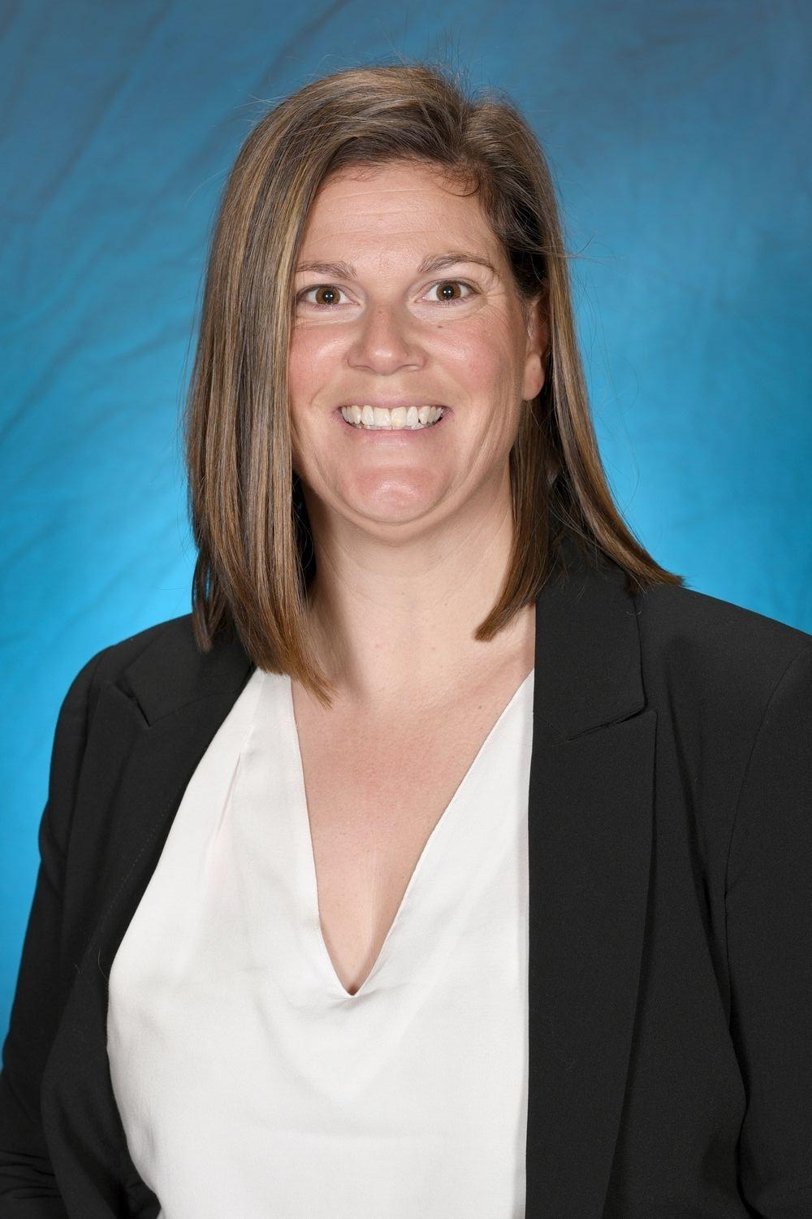
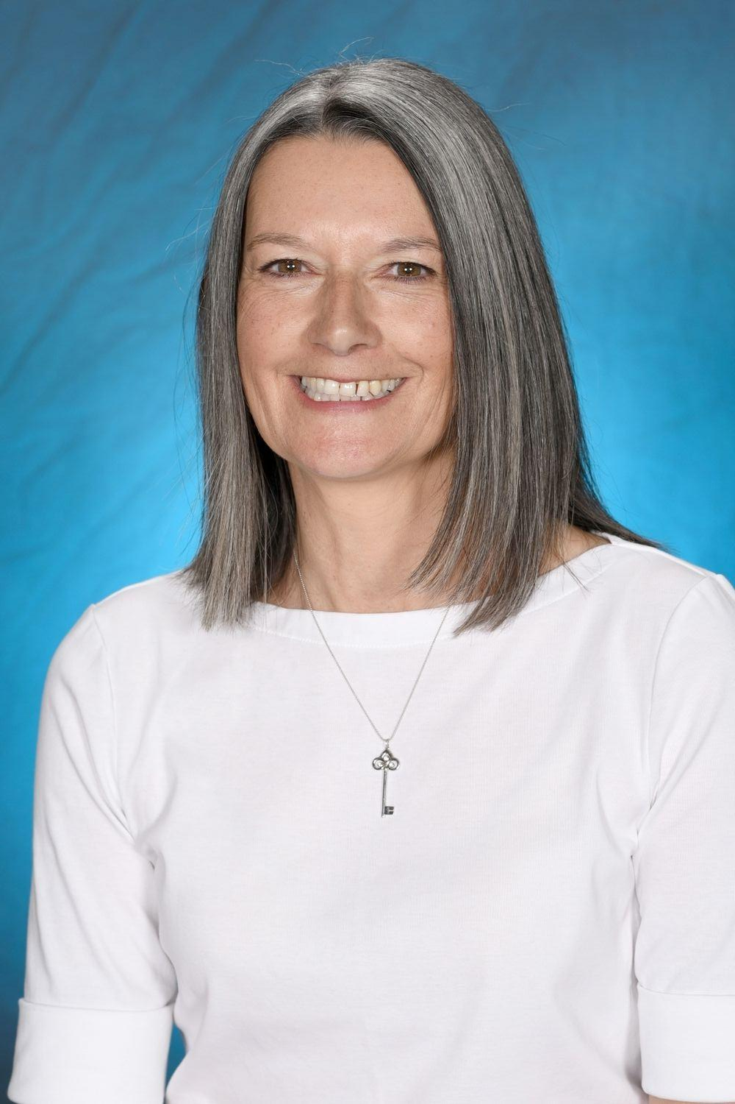
K-2 Team
K-2 Assistant Principals
Kindergarten Teachers
Year 1 & 2 Teachers
Year 1 & 2 Teachers
Mrs McTackett (Rel. AP - Welfare)
Mrs Rainford (Rel. AP Curriculum)
KSK - Mrs Kotevich
Mon-Tues
- Mrs Simmonds
Wed-Fri
KR - Mrs Riganias
1/2NW - Mrs Nunn
Mon, Thurs-Fri
- Mrs Worboys
Tues-Wed
1/2M -Mrs McTackett
1/2R -Mrs Rainford
2/3M - Mrs Malakonakis

Slide 3
Support Team
Teacher Librarian - Mrs Dufty
EAL/D - Ms Jones
LaST - Ms Maloney
Additional support - Mrs Kotevich and Mrs Worboys
RFF - Mrs Androulakis and Mrs Anastasiou
Student Learning and Support Officers - Mrs Targett, Mrs Wootton and Mrs Ryan
Student Welfare and Support Officer - Miss Savage
School Counsellor - Ms Burgess
The Support Team works with our K-2 students to provide support in learning and wellbeing. A parent referral is needed to access wellbeing support.
Notes:
Michelle

Slide 4
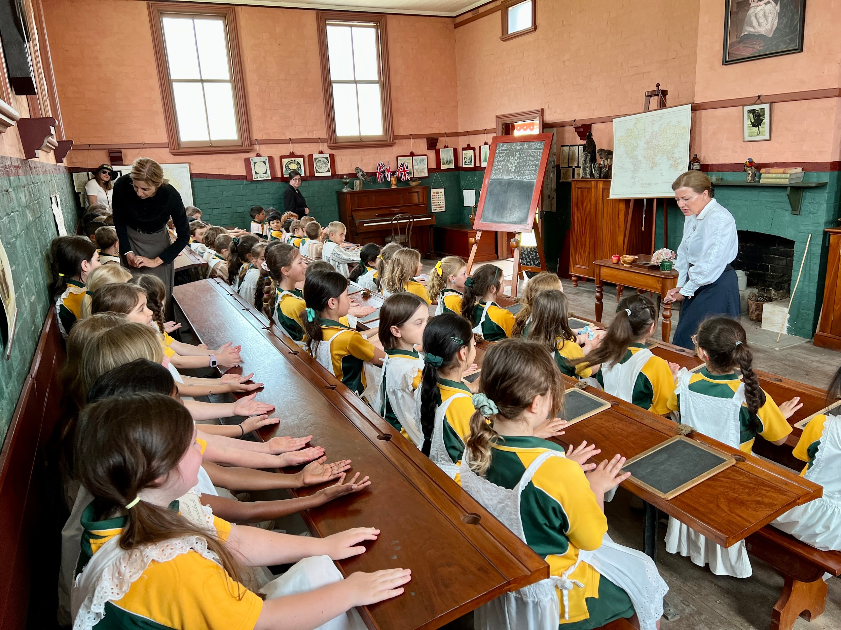
Curriculum KLAs

Slide 5
K-2 English and Mathematics
Please follow the link below to learn more about K-2 Curriculum Reform.
Parents and Carers | NSW Curriculum Reform
English
Oral language and communication Vocabulary
Phonological awareness (ES1) Print conventions (ES1)
Phonic knowledge Reading fluency
Reading comprehension Creating written texts
Spelling Handwriting
Mathematics
Number and Algebra - Representing whole numbers, combining and separating numbers, forming groups
Measurement and Space - geometric measure, 2D and 3D spatial structure, Non-spatial measure
Statistics and probability - data and chance
Working Mathematically - embedded throughout learning
Science
Through studying Science and Technology students explore scientific and technological concepts and gain knowledge and understanding of the world. They develop skills in conducting scientific investigations and designing and producing solutions through learning about the Living World, Material World, Physical World, Earth and Space, and Digital Technologies.
Notes:
Michelle

Slide 6
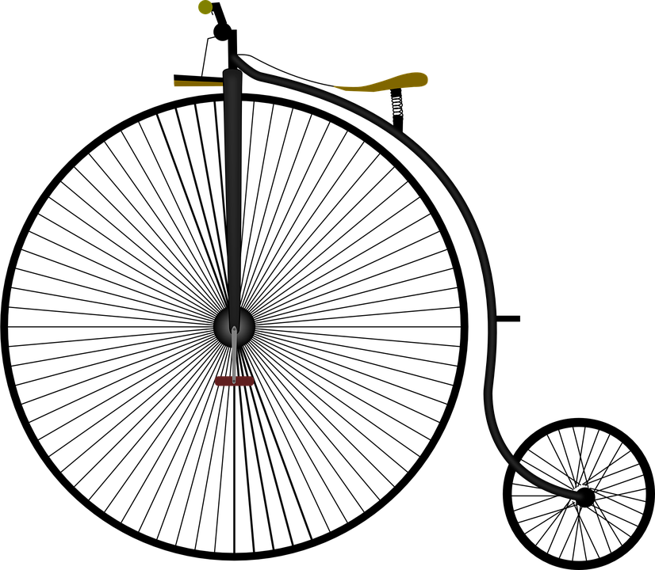
History and Geography
History
The aim of the History syllabus is to stimulate students’ interest in and enjoyment of exploring the past, to develop a critical understanding of the past and its impact on the present, to develop the critical skills of historical inquiry and to enable students to participate as active, informed and responsible citizens.
Geography
The aim of Geography in Years K–10 is to stimulate students’ interest in and engagement with the world. Through geographical inquiry they develop an understanding of the interactions between people, places and environments across a range of scales in order to become informed, responsible and active citizens.
Notes:
Michelle

Slide 7
PDHPE
Personal Development and Health
School and Class Expectations
Bounce Back including Anti-bullying and mindfulness
Drug Education, Child Protection, Road Safety
Physical Education and Sport
CAPA
Dance
Drama
Music
Visual Arts
OTHER
ICT
Library
Special Religious Education and Ethics
Notes:
Michelle

Slide 8
Exercise Your Brain
Revision of what is covered in class
Distributed on Mondays in home reading folders
Home reading to commence in term 2 when students have been exposed to a greater number of phonemes
Decodable texts are specifically written for beginning readers as they are developing their blending and segmenting skills and their knowledge of the alphabetic code. Decodable texts contain a very large percentage of words that incorporate the letter-sound relationships that students have been taught.
Mathletics to begin in term 2 - more information will be provided closer to the time.
Notes:
Michelle

Slide 9
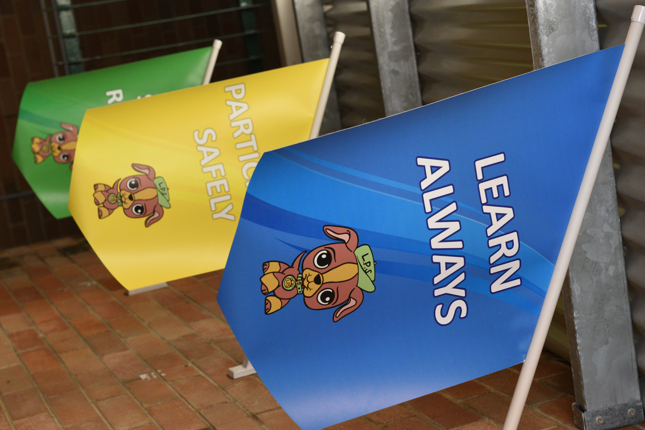
General Information

Slide 10
School Uniform
The Uniform shop is open on Monday and Thursday mornings from 8:30am to 9:30am
Volunteers will fill orders and return to you via your child.
Online orders through the app Qkr!
Sports uniform on Tuesdays and Thursdays for K-2 students
Black school shoes every day except Tuesdays and Thursdays
A school hat should be worn every day
Notes:
Nicolette

Slide 11
Food
Crunch and Sip (time varies for each class) please provide cut up fruit or vegetables, and water
Recess and Lunch should be easy to open or unwrap. Try not to send packaged food or food that is wrapped too tightly in cling wrap that is hard for students to open independently.
Nut-Aware School Please be mindful that we have students who are allergic to nuts
Birthday Treats Current guidelines discourage the sharing of birthday treats such as cupcakes with classmates; an alternative option is to purchase a class pack of ice blocks from our school canteen.
Notes:
Nicolette

Slide 12
School Canteen
Open Monday, Wednesday and Friday (Closed Tuesdays and Thursdays)
Run by volunteers
See Sharon in canteen if you would like to volunteer
Lunch orders to be made online (through Qkr!)
Alternates between Summer and Winter menus
Notes:
Nicolette

Slide 13
Student Wellbeing
High Expectations
Whole school approach to setting expectations for student behaviours
Teachers will give explicit lessons on the behaviours that are expected of students
Each week there will be a focus area for the whole school
The expectations are:
Learn Always
Participate Safely
Show Respect
Notes:
CK

Slide 14
Student Wellbeing
Positive behaviour is rewarded by Blue, Yellow and Green Garnos that represent our school expectations of Learn Always, Participate Safely and Show Respect
10 Garnos =1 LPS Values Award
5 LPS Values Awards =1 Principal’s Award
Every set of 3 Principal’s Awards =1 Book Award
5 Principal’s Awards =1 Values Medallion
10 Principal’s Awards = 1 LPS Excellence Plaque
Playground Garnos - Winning Sport House earns a reward
Notes:
CK

Slide 15
Wellbeing at a Glance
Values Plaque
School Core Values (LPS)
Student Expectations Matrix
Specific lessons in class
Bounce Back - a resilience program
Anti Bullying
Mindfulness
Medallion
Principal’s Award
Book Award
Values Award
Garno’s
Notes:
CK

Slide 16
School Behaviour Support and Management Plan
A new DoE Behaviour Policy has clear guidelines around student safety, respect and engagement, and impact on teaching and learning. Our approach is, Positive, Safe, Respectful, Inclusive
Establish expectations for behaviour in class, on the playground and around the school
Explicitly teach and model positive behaviour
Promote and reinforce positive student behaviour and school wide expectations
Prevent and respond to student behaviours of concern
Restorative practices, detention and reflection
For further information on the Department’s new Behaviour Policy, please refer to the link below:
https://education.nsw.gov.au/policy-library/policyprocedures/pd-2006-0316/pd-2006-0316-01
Parents and carers play an important role in our school community. Student wellbeing is enhanced when the school and families work in partnership. The Community Charter outlines the responsibilities of parents, carers, educators and school staff in NSW public schools to ensure our learning environments are collaborative, supportive and cohesive.
Notes:
CK

Slide 17
Mobile Phones, Smartwatches and Devices
The Department of Education has clear guidelines around the use of mobile phones and smartwatches. Please see link below.
Student Use of Mobile Phones in Schools
Our school’s expectations are outlined in our Mobile Phone and Smartwatch Policy Agreement
This applies to all devices where communications and recordings
may be made, including junior versions of a smartwatch, and
walkie talkies.
Notes:
CK

Slide 18
Making Appointments
Absences
Please see the class teacher first for any issues of concern
An appointment may be made by contacting the school.
SENTRAL will automatically push out unexplained attendance notifications. Please ensure you have downloaded the SENTRAL for Parents App and update your details via the office. Please see or call our office for SENTRAL help.
A note explaining the reason for your child’s absence is required within 7 days
These notes may be submitted online via SENTRAL or to your child’s teacher. We are phasing out the option of submitting absences via the link on our school website
Attendance is regularly monitored by the school and a Home-School Liaison Officer
Partial Absences
Please try to avoid, where possible, appointments during school hours
It is also important to be punctual to school
Notes:
Nicolette

Slide 19
Notes:
Nicolette

Slide 20
Communication
Fortnightly Newsletters-online
LPS Website
Sentral for Parents app
Lugarno Public School Facebook page - regularly updated with the most current information, news and events
All notes are sent home via the Sentral Parent Communication app - please ensure notifications are enabled
A list of notes is included in the newsletter-please check
Please ensure your contact details are up to date. This can be done through the office
Notes:
Nicolette

Slide 21
Payment Policy
Payments may be made online via the Sentral Parent Communication app
A black letterbox is at the front office; any money/notes are to be dropped off there at the beginning of the day
Due date is strictly adhered to
Please contact school immediately if unable to pay to avoid disappointment
Notes:
CK

Slide 22
Permission to Publish
Upon enrolment, our school seeks Permission to Publish photographs of your child and their work. Annually, our school will also request this permission via a note at the beginning of the year.
These photographs may be included in the school newsletter, school Facebook page, Instagram post, Google Classroom or a P&C promotion. If published, third parties will be able to view these photographs and/or work.
Notes:
CK

Slide 23
Interviews and Reports
Interviews will be in Weeks 10 and 11, Term 1
Semester One Reports sent home at the end of Term 2
Semester Two Reports sent home at the end of Term 4
Contact the class teacher for an appointment, if there are any concerns with your child’s progress or wellbeing.
Notes:
CK

Slide 24
Pick up Routines
Students’ safety and wellbeing are paramount
Authorised people only to pick up students
Please advise classroom teacher (in writing) if another adult is picking up your child
OOSH care staff personally come across to pick up students
Call the school before 2:20pm if you are running late-your child will be supervised by an Assistant Principal
Notes:
Nicolette

Slide 25
P&C
The P & C is a group of parents and carers who volunteer their time and skills to assist the Principal and the school in order to enhance the school experience and learning environment for students. This involves running the school canteen, uniform shop and numerous fundraising activities.
Please see the P&C’s fortnightly newsletters for current events and information, and if you would like to join.
The P & C meet once a month on the 3rd Wednesday of the month at 7pm
The first meeting of the year is tonight at 7pm in the school library.
Notes:
Nicolette

Slide 26
Question Time
Thank you for joining us this afternoon.
Please remember that this is a general information session. If you have a question that relates specifically to your child, then please make a time to see your child’s teacher.

